Slide 1
Practical Crypto Review for Developers

Slide 2
About This Presentation
We’re going to look at
Common crypto mistake that developers often make
The impact when those mistakes are made
How to avoid making those mistakes
This presentation has been edited to fit the time allotted
Could easily do a second and probably a third presentation

Slide 3
About This Presentation cont’d
This presentation is available at github/ddillard/Presentations
Speaker notes have references to source material
Made available under Creative Commons Attribution 4.0 International License
Some images included under different license/fair use
Notes:
For licensing specifics see https://creativecommons.org/licenses/by/4.0/legalcode and https://creativecommons.org/licenses/by/4.0/

Slide 4
A Little About Me
Product developer for over twenty years
Mostly system level software, e.g. device drivers and file system driver
Moved to application security about ten years ago
A member of the Symantec Product Security Group for about six years
Lots of work with enterprise class data products and some security products

Slide 5
Me and Crypto
I’m not a crypto expert
I’m not even an applied crypto expert
But I have learned a lot of the mistakes that developers make when implementing crypto in their software

Slide 6

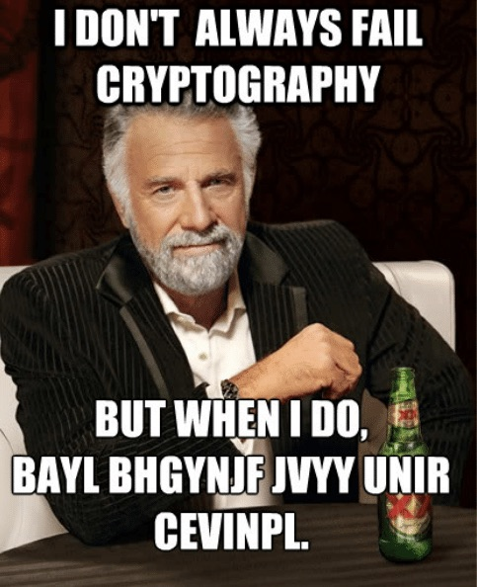



Crypto Is Hard

Slide 7
Crypto is Hard
With crypto often many things must be done correctly
If even one of those things is done incorrectly it can potentially compromise the security of the data you’re trying to protect
It’s often difficult to determine if something was done incorrectly
And it’s usually very difficult to tell only looking at the ciphertext

Slide 8
Which Output is From a Broken Implementation?
Output 1
Output 2
79 59 C2 F2 - 7E C1 D0 D6
A3 2B CD 05 - BA CE EA BB
79 59 C2 F2 - 7E C1 D0 D6
A3 2B CD 05 - BA CE EA BB
Notes:
Yes, they are the same!
Sometimes just looking at the ciphertext doesn’t tell you if you have an issue or not, particularly if you have only one ciphertext.

Slide 9
Real World Example
Bitcrypt ransomware authors tried to create an RSA key of 1024 bits, i.e. 128 bytes
Created a key of 128 decimal digits instead!
About 426 bits
Can be easily cracked in a day
You had one job…
Notes:
Source: https://www.virusbulletin.com/blog/2014/02/researchers-crack-ransomware-encryption

Slide 10
Why is Crypto Hard?
2018 Study on Crypto API Usability found that:
20% of developers thought that they had completed crypto task securely when they had not
APIs often have poor documentation that don’t necessarily explain crypto issues
APIs sometimes have poor defaults
Insecure examples
Information about all the little “gotchas” isn’t easy to find
Notes:
Study on crypto API usability:
Paper: https://www.cl.cam.ac.uk/~rja14/shb17/fahl.pdf
Presentation: https://www.youtube.com/watch?v=ALUq2Kc2YxA

Slide 11
Why is Crypto Hard?
2018 Study on Crypto API Usability found that:
20% of developers thought that they had completed crypto task securely when they had not
APIs often have poor documentation that don’t necessarily explain crypto issues
APIs sometimes have poor defaults
Insecure examples
Information about all the little “gotchas” isn’t easy to find
Notes:
Study on crypto API usability:
Paper: https://www.cl.cam.ac.uk/~rja14/shb17/fahl.pdf
Presentation: https://www.youtube.com/watch?v=ALUq2Kc2YxA

Slide 12
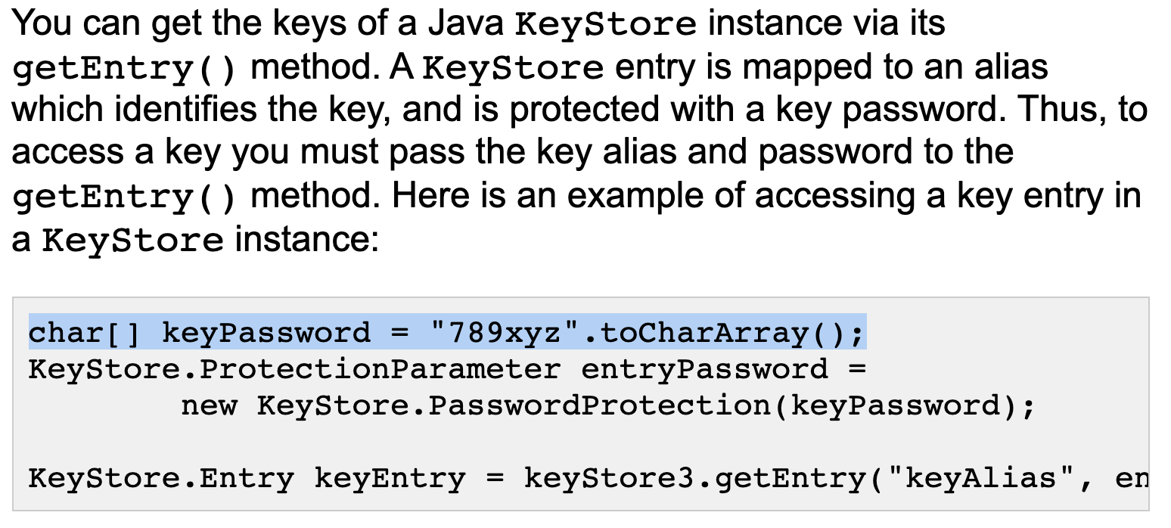
Insecure Examples
Notes:
Source: http://tutorials.jenkov.com/java-cryptography/keystore.html

Slide 13

Use Standard Crypto Algorithms

Slide 14
Use Standard Crypto Algorithms
Always use standard crypto algorithms
Don’t invent your own crypto and expect it be secure
Beware of developers creating custom algorithms using standard crypto primitives
Developer may not realize he’s doing that
Example: Custom key derivation function

Slide 15
Use Standard Crypto Algorithms
“Anyone, from the most clueless amateur to the best cryptographer, can create an algorithm that he himself can't break.”
－ Bruce Schneier
Notes:
Quote: https://www.schneier.com/blog/archives/2011/04/schneiers_law.html
Photo: https://en.wikipedia.org/wiki/Bruce_Schneier#/media/File:Bruce_Schneier_at_CoPS2013-IMG_9174.jpg
A more detailed version fof the same idea rom PGP creator Phil Zimmerman: “When I was in college in the early seventies, I devised what I believed was a brilliant encryption scheme. A simple pseudorandom number stream was added to the plaintext stream to create ciphertext. This would seemingly thwart any frequency analysis of the ciphertext, and would be uncrackable even to the most resourceful government intelligence agencies. I felt so smug about my achievement.
Years later, I discovered this same scheme in several introductory cryptography texts and tutorial papers. How nice. Other cryptographers had thought of the same scheme. Unfortunately, the scheme was presented as a simple homework assignment on how to use elementary cryptanalytic techniques to trivially crack it. So much for my brilliant scheme.”
https://philzimmermann.com/EN/essays/SnakeOil.html

Slide 16
Use Standard Crypto Algorithms
Synopsys commenting on IBM JCE RNG issue
“Secure pseudo-random number generation is hard. Even widely used pseudo-random number generators from reputable vendors can contain security issues. If you rolled your own pseudo-random number generator without help from cryptography experts, assume that it’s insecure.”
Notes:
Source: https://www.synopsys.com/blogs/software-security/recent-fixes-ibmsecurerandom/

Slide 17
Use Existing Implementations
Whenever possible use widely used crypto libraries from people who know crypto
The more widely used it is the more likely obvious issues have been found and fixed or will be fixed
Do not create an implementation of a standard algorithm if you can help it
Try to avoid implementations of standard algorithms from non-experts
Avoiding implementation issues such as side channel attacks is hard
OpenSSL has fixed eight side channel vulnerabilities in the last seven years

Slide 18

Protect Cryptographic Secrets
Secrets are things like passwords, symmetric keys, private keys and key stores
Protecting them can mean
Encrypting them, e.g. key wrapping
Using ACLs to prevent unauthorized access
Storing them in special hardware such as a TPM or HSM

Slide 19
Protecting Secrets Failure
Both Nikon and Canon have a feature on their higher end cameras to digitally sign photos taken by the camera
This is a useful feature for news and forensics work where it’s important to be able to show that an image has not been altered
Russian firm ElcomSoft was able to extract the private keys used to sign photos from the firmware of cameras from both vendors

Slide 20
When Your Private Key is No Longer Private
Notes:
Source: https://petapixel.com/2010/12/01/russian-software-firm-breaks-canons-authenticity-verification-big-time/

Slide 21
Random Numbers
Notes:
Source: https://xkcd.com/221/

Slide 22
Random Numbers
Random numbers are fundamental to cryptography
Required for probabilistic encryption
Used to generate keys, IVs, salts, etc.
Random numbers must truly be random, if they are predictable,that can result in the total compromise of the crypto system
Notes:
https://en.wikipedia.org/wiki/Probabilistic_encryption

Slide 23
Random Number Generation
Mistake to use non-cryptographically secure RNGs
Examples
rand() in C/C++
Random() in Java
Math.Random() in JavaScript
Mersenne Twister in any language

Slide 24
Random Number Generation
Always use a cryptographically secure random number generator
CSPRNG – Cryptographically Secure Random Number Generator
DRBG – Deterministic Random Bit Generator
NIST recommends three methods to implement DRBGs
NDRG – Non-deterministic Random Bit Generator
Usually based on hardware, e.g. Intel’s RDSEED instruction
Notes:
NIST recommendations for DRBGs: https://nvlpubs.nist.gov/nistpubs/SpecialPublications/NIST.SP.800-90Ar1.pdf
RDSEED: https://software.intel.com/en-us/articles/intel-digital-random-number-generator-drng-software-implementation-guide, https://software.intel.com/en-us/blogs/2012/11/17/the-difference-between-rdrand-and-rdseed

Slide 25
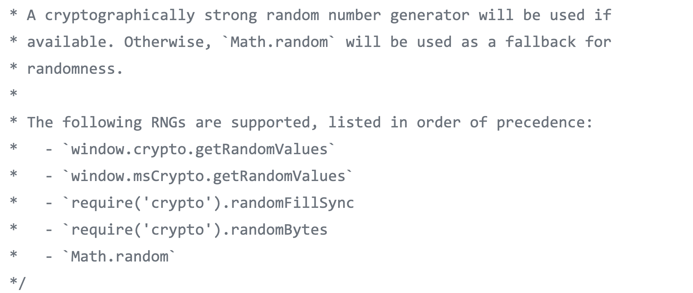
Random Number Failure
Notes:
Particularly insidious because you don’t know it’s using an insecure implementation without testing it
Source: https://github.com/jupyterlab/lumino/blob/52b15d88cd0e647c40bd1d6a265817b7cc6458a2/packages/coreutils/src/random.ts

Slide 26
Seeding a DBRG
With standard DRBGs (hash, HMAC and stream cipher, e.g. CTR) security of generated numbers depends upon entropy of seed
NIST recommends a minimum of 112 bits of security today
So need a minimum 112 bits of entropy in the seed to the DRBG
Though the seed is generally much longer
More entropy is better
Notes:
NIST recommendations for DRBGs: https://nvlpubs.nist.gov/nistpubs/SpecialPublications/NIST.SP.800-90Ar1.pdf

Slide 27
Seeding of Random Number Generators
I’ve seen crazy ways of seeding RNGs, for example:
E.g. a string of a system name and the current time as a string run through a hash function
The amount of entropy in this case is NOT the output of the hash
7-Zip used to hash the process ID, thread ID, and system uptime to seed its custom RNG on Windows
Notes:
See in CRandomGenerastor::Init in https://github.com/mcmilk/7-Zip/blob/fabc2d1d468c61ac8e3adee752580519fc8bb91d/CPP/7zip/Crypto/RandGen.cpp

Slide 28

Time as an Entropy Source
Time is a very poor entropy source
31,536,000 seconds in a year
One year provides less than 25 bits of entropy
100 years provide less than 32 bits of entropy
Those numbers are optimistic, attacker can often narrow down time to a few minutes or even seconds
Time can be used in conjunction with other entropy sources
But is grossly insufficient by itself
Want a minimum of 112 bits and at best time gives us 24-31 bits
In most environments better sources of entropy are available
Notes:
Note: clock image is licensed CC BY NC ND.

Slide 29
Entropy is Very Important
“Back when the NSA was routinely weakening commercial cryptography, their favorite technique was reducing the entropy of the random number generator.”
－ Bruce Schneier
Notes:
Source: https://www.schneier.com/blog/archives/2008/05/random_number_b.html

Slide 30
Debian OpenSSL Fiasco
Debian developer removed hashing of uninitialized data buffer
Hash value used as part of RNG seed
This buffer was intentionally left uninitialized
Good place for a comment about why it was done
This reduced the entropy used to initialize the RNG to 15 bits
This meant that the RNG had just 32,768 initial states
Very easy to brute force
This resulted in the same keys being generated, e.g. public/private key pairs, many many times
Took over 18 months for issue to be noticed and fixed
Notes:
Source: https://www.schneier.com/blog/archives/2008/05/random_number_b.html
Android had a similar issue which led to the theft of Bitcoin, see https://android-developers.googleblog.com/2013/08/some-securerandom-thoughts.html

Slide 31

Symmetric Key Generation

Slide 32
Symmetric Key Generation
Either create keys using a cryptographically secure RNG or using a standard key derivation function (KDF)
Create keys when needed
Never embed keys in a program, i.e. a static key

Slide 33
Don’t Use Static Keys
HC6 ransomware used a static key
Once the key was found it was easy to develop a decrypter
Moral of the story
If good guys can find static keys in malware
Then bad guys can find static keys in your software
Notes:
Source: https://www.youtube.com/watch?v=BlEoAPO_yxc, at 31:00

Slide 34
Symmetric Key Derivation
Keys created using key derivation functions (KDFs) such as PBKDF2 and HKDF
KDFs combine multiple sources of entropy, “stir” it up using a work factor to create a symmetric key
Typical sources of entropy include
User supplied password
Random number generator

Slide 35
Keys Derived from Secrets
Derived from secrets such as user supplied passwords
I’ve also seen non-secrets used such as
System names
Current date/time
These rely on the secrecy of the source used and are easily brute-forced if learned by an attacker
Remember Kerchoff’s Principle: “A cryptosystem should be secure even if everything about the system, except the key, is public knowledge.”
Or more generally "A cryptosystem should be secure even if everything about the system, except the secret, is public knowledge.”
Notes:
https://en.wikipedia.org/wiki/Kerckhoffs%27s_principle

Slide 36
Insufficient Entropy
Same general issue as with seeding an RNG
Want enough entropy so brute forcing a derived key is not feasible
Date and time is a poor source of entropy
Fine to add it to other entropy but it shouldn’t be your only source

Slide 37
Symmentric Encryption Modes
Notes:
Image: https://en.wikipedia.org/wiki/Block_cipher_mode_of_operation#/media/File:CBC_encryption.svg

Slide 38
Symmetric Encryption Modes
ECB, CTR, GCM and CBC
There are other modes, e.g. SIV, CCM, EAX, etc. however I don’t have much experience with them so they aren’t covered in this presentation
Generally prefer GCM mode to the others when it can be used
GCM is authenticated
ECB, CTR and CBC are not
There are other authenticated modes, e.g. SIV, CCM and EAX
Notes:
GCM: https://en.wikipedia.org/wiki/Galois/Counter_Mode
Authenticated encryption: https://en.wikipedia.org/wiki/Authenticated_encryption

Slide 39
Let’s Define a Few Terms
Authenticate Encryption
Nonce
Birthday problem/paradox
Initialization Vector (IV)

Slide 40

Authenticated Encryption
Authenticated encryption doesn’t mean that Bob can tell that Alice created the ciphertext
It means that Bob can tell if the ciphertext has been altered by an Eve or not
This adds overhead to the ciphertext
Ciphertext is longer than plaintext
This restricts where it can be used
Notes:
History of Alice and Bob: https://boingboing.net/2017/07/19/heteronormative-exemplars.html
Eve defends her actions: https://xkcd.com/177/

Slide 41
Nonce
Number used (only) once
In a particular context
If used more than once then “bad” things could happen
How bad depends upon the context
Usually either a counter or a random number
Notes:
Nonce: https://en.wikipedia.org/wiki/Cryptographic_nonce

Slide 42
Birthday Problem/Paradox
Name comes from the likelihood that two random people may have the same birthday
If you have a room with 23 people in it then the odds are better than 50% that two of those people have the same birthday
With only 70 people the odds are over 99.9% that two of them will have the same birthday
The number of people needed to get these odds is much lower than most people would expect
Notes:
Birthday problem: https://en.wikipedia.org/wiki/Birthday_problem

Slide 43
Birthday Problem cont’d
The birthday problem is relevant in crypto because many times we have a nonce that is a random value
Sometimes it’s specified by a developer
Sometimes it’s a calculated value
We rely on that random value not ever repeating, but the more times we use a random value the higher the odds that a new value will be the same as a previously used value
As a result we want to limit the number of operations so that the odds of a repeated value are very low
Notes:
Great discussion of an application of this: https://books.google.com/books?id=nnqdQsrZnJgC&pg=PT144&lpg=PT144#v=onepage&q&f=false

Slide 44
Initialization Vector (VI) for Block Encryption
Block encryption modes use some sort of derived data to manipulate plain text before encrypting it
CBC mode XORs the plaintext with the ciphertext of the previous block
CTR mode XORs the plaintext with the counter
Need a way to specify what this data is for the first block that is encrypted, this is the IV
IVs are not secrets
Notes:
See https://en.wikipedia.org/wiki/Initialization_vector#Block_ciphers

Slide 45
ECB Mode
Only secure when encrypting a single block of data one time
With AES a block is 16 bytes
Any other use is insecure and since most data is more than a block size ECB mode is rarely intentionally used
Because it only works on a single block it doesn’t use an IV or nonce like other modes

Slide 46
ECB Mode cont’d
Default mode with Java when using the standard Sun crypto provider is ECB mode
Notes:
Java default: https://stackoverflow.com/questions/6258047/java-default-crypto-aes-behavior

Slide 47
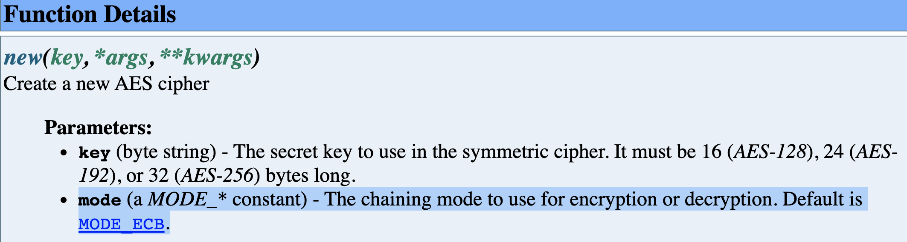
ECB Mode cont’d
ECB mode is the default mode when using pycrypto as well
Notes:
https://www.dlitz.net/software/pycrypto/api/current/Crypto.Cipher.AES-module.html

Slide 48
AES CTR Mode
IV is a 16 byte nonce
Implementations automatically increment the IV for each block that is encrypted
Hence the name “counter mode”
If key is only used for encryption once then can safely use any IV
If key is used multiple times then IV is typically partitioned into a nonce space and a counter space
8 byte nonce and 8 byte counter
12 byte nonce and 4 byte counter
Notes:
Source: https://nvlpubs.nist.gov/nistpubs/Legacy/SP/nistspecialpublication800-38a.pdf

Slide 49
AES CTR Mode IV Reuse
If IV is reused creates possibility for an attack
C₁ ⊕ C₂ = P₁ ⊕ P₂
Attacker cannot determine encryption key, but
May be able to use natural language processing or other means to determine data
The more cipher texts that are available the more likely an attacker can determine some or even all of the encrypted data
NIST “if any plaintext block that is encrypted using a given counter block is known ... This output allows any other plaintext blocks that are encrypted using the same counter block to be easily recovered from their associated ciphertext blocks. ”
Notes:
NIST source: https://nvlpubs.nist.gov/nistpubs/Legacy/SP/nistspecialpublication800-38a.pdf, first paragraph of Appendix B

Slide 50
AES CTR Mode Reuse IV
Notes:
https://twitter.com/angealbertini/status/425561082841690112

Slide 51
Problem #1: Explicit Reuse of IV
Key/IV pair is explicitly reused
For example, encrypt data multiple times using a single key and an IV of 0

Slide 52
Problem #2: Implicit Reuse of Counter
Key/IV pair is not reused, but there is overlap in counters
Remember the counter is incremented every time a block is encrypted
So if we start with IV of 0 and encrypt 16K of data at the end the counter will be at 1024
If we encrypt more data with the same key and IV of 1 then we will reuse 1023 IVs
I’ve seen an implementation that generated multiple random 16 byte IVs (not partitioned) and used them with same key. Might be ok, but the more times something is encrypted and the larger the data that is encrypted the more likely there will be an overlap – thus creating a possibility for an attack.

Slide 53

AES GCM Mode
Built on CTR mode
Takes developer provided nonce to generate an IV
Repeated use of nonce with key creates possibilities of attack
Provides authenticated encryption through the use of tags
“AES GCM is brittle, it doesn’t bend – it breaks”
Notes:
Source of quote: https://crypto.stackexchange.com/questions/75821/does-hmac-provide-anything-that-aead-does-not

Slide 54
AES GCM Nonce
The nonce is used to generate an IV
NIST recommends a 12 byte nonce “to promote interoperability, efficiency, and simplicity of design.”
Also improves security ”As long as the IV is 96 bits there is never a collision in the CTR mode encryption.”
When using randomly generated IVs NIST recommends a maximum of 2³² IVs with a specific key
“if even one IV is ever repeated, then the implementation may be vulnerable to the forgery attacks… In practice, this requirement is almost as important as the secrecy of the key. “
Notes:
NIST recommendations for GCM: https://nvlpubs.nist.gov/nistpubs/Legacy/SP/nistspecialpublication800-38d.pdf
Ferguson on GCM: https://csrc.nist.gov/csrc/media/projects/block-cipher-techniques/documents/bcm/comments/cwc-gcm/ferguson2.pdf

Slide 55
AES GCM Maximum Encrypted Data
There is a 64 GB – 64 byte limit on the amount of data that can be securely encrypted with a key/IV pair
If you go over that limit reduces security
Could get to the point that an attacker could forge messages
Notes:
NIST recommendations for GCM: https://nvlpubs.nist.gov/nistpubs/Legacy/SP/nistspecialpublication800-38d.pdf

Slide 56

GCM Authentication Tag Length
Authentication tag is used to verify the integrity of the data
Tags can be 32, 64, 96, 104, 112, 120 or 128 bits long
Always prefer 128 bit tags
Provides the best security
Shorter tags increase the probability of an attacker successfully forging encrypted data
TLS and SSH GCM use 128 bit tags
Never mix tag lengths on a key
Notes:
Shorter tags are bad: https://csrc.nist.gov/csrc/media/projects/block-cipher-techniques/documents/bcm/comments/cwc-gcm/ferguson2.pdf
TLS RFC: https://tools.ietf.org/html/rfc5288#section-3
SSH RFC: https://tools.ietf.org/html/rfc5647#section-6.3
Person who says that 128 bit tags should be used whenever you’re encrypting more than 1 MB of data: https://crypto.stackexchange.com/questions/31849/is-the-length-limit-of-aes-gcm-per-key-or-per-key-nonce-pair

Slide 57
AES CBC Mode
Takes developer provided 16 byte IV
IVs should not be predictable to an attacker
IVs should not be reused
Not authenticated
Notes:
https://crypto.stackexchange.com/questions/10505/reusing-keys-with-aes-cbc/10511#10511

Slide 58
AES CBC Mode IV Value
When encrypting IV must be unpredictable to an attacker that can cause plaintext to be encrypted
Usually done by generating a random IV
Other non-random constructs can also work
IV must also be a nonce
I’ve seen implementations with very predictable IV values
Compile time constants
Generated randomly once, but then repeatedly used with the same key

Slide 59

AES CBC Mode IV Length
Should be 16 bytes
i.e. the AES block size
Sometimes see length of 32 bytes
Developers confusing block size and key size
This is not a security issue, however it’s a flashing yellow light to examine the crypto in greater detail – if the developer made this mistake perhaps (s)he made others as well
7 Zip once used a length of 8 bytes
No idea why that mistake was made
A potential security risk – half the IV was predictable
Notes:
Source for 7 Zip issue: https://www.7-zip.org/history.txt (19.00 release)

Slide 60
Contrasting Modes
IVs are nonces
CBC, CTR and GCM all must provide nonce
With CBC mode an IV related issue can occur with a single use of a key/IV pair
With CTR and GCM modes an IV/nonce related issue cannot occur with a single use of a key/IV pair

Slide 61

Encrypting Too Much Data with a Single Key
Potential problem with any mode
”All block cipher modes leak some information.”
The more data encrypted with a particular key the more information that is leaked to an attacker, increasing the risk of a successful attack
With CBC mode older guidance had been to limit the amount of data encrypted to about 2³² blocks and with CTR mode to about 2⁶⁰ blocks for a particular key
Doesn’t matter how many IVs/nonces are used
CTR was larger because there was no chance of collision due to birthday problem as there is with CBC
Notes:
See https://books.google.com/books?id=nnqdQsrZnJgC&pg=PT142&lpg=PT142&dq=%22All+block+cipher+modes+leak+some+information%22&source=bl&ots=6G2TBfmAwa&sig=ACfU3U0QeWIoV9NBJjJJ2mtITq0wgXtg1Q&hl=en&sa=X&ved=2ahUKEwjxm93e8LHnAhVPS6wKHTVkDKUQ6AEwAnoECAcQAQ#v=onepage&q=%22All%20block%20cipher%20modes%20leak%20some%20information%22&f=false

Slide 62
Encrypting Too Much Data with a Single Key cont’d
Recent research has found that CTR mode leaks other information
The authors of that paper recommend treating CTR mode similarly to CBC
May want to limit CTR mode to the range of 2³² blocks to 2⁴⁰ blocks
That’s 64 GB to 16 TB
Notes:
See https://eprint.iacr.org/2018/159.pdf

Slide 63
Encrypting Too Much Data with a Single Key cont’d
Like with everything else in security it’s about how much risk you’re willing to accept
What kind of data are you protecting?
How long must the data be secure?
Can you rewrite data in the future to keep it safe?
Who’s your anticipated attacker?
If you have critical data, that needs to be secure for a long time and can’t be rewritten you may want to go much lower than 64 GB
Remember old saying from NSA: “attacks only get better; they never get worse”
Notes:
”Attacks only get better” source: https://www.schneier.com/blog/archives/2005/02/cryptanalysis_o.html

Slide 64
Outdated Crypto

Slide 65
RC4
aka arcfour
RC4 is the trademarked name
Stream cipher
Biases, particularly at the beginning of the output the stream
Used in TLS, SSH and some RNGs
Many projects on github still use RC4 based RNGs
Some projects have also replaced their RC4 based RNGs
OpenBSD in 2014
Chrome in 2016
Notes:
https://en.wikipedia.org/wiki/RC4
OpenBSD manual stating release when arcfour was replaced: https://man.openbsd.org/arc4random
CVE for RC4 based CSPRNG in Blink/Chrome: https://nvd.nist.gov/vuln/detail/CVE-2016-1618
Image: https://en.wikipedia.org/wiki/RC4#/media/File:RC4.svg

Slide 66
MD-5, SHA-1
SHA-1 deprecated by NIST in 2011
Should never be used for ID’ing something, e.g. hash of a signature
However, is still secure for some constructs such as HMAC-SHA1
Even then suggest moving to something better when available
Just a matter of priority
Notes:
Proof of HMAC security not relying on collision resistance: http://cseweb.ucsd.edu/~mihir/papers/hmac-new.html
Draft RFC deprecating MD-5 and SHA-1 in TLS, specifically doesn’t deprecate HMAC-SHA1: https://tools.ietf.org/html/draft-ietf-tls-md5-sha1-deprecate-01

Slide 67
SSL/TLS
Use TLS 1.3 and 1.2
Don’t use TLS 1.1, 1.0 or any version of SSL
Draft RFC to deprecate TLS 1.1 and 1.0
Many libraries are going to this configuration by default
So are all major browsers
If using TLS 1.2 don’t use cipher suites that include RC4 or 3DES
CVE for RC4 was published in 2013
RFC deprecating RC4’s use in TLS was published in 2015
3DES is deprecated by NIST and has been removed from protocols such as Kerberos
Notes:
TLS
https://www.entrustdatacard.com/blog/2018/november/deprecating-tls
https://tools.ietf.org/html/draft-ietf-tls-oldversions-deprecate-06
RC4
https://nvd.nist.gov/vuln/detail/CVE-2013-2566
https://tools.ietf.org/html/rfc7465
3DES
https://nvlpubs.nist.gov/nistpubs/SpecialPublications/NIST.SP.800-131Ar2.pdf
https://tools.ietf.org/html/rfc8429

Slide 68
SSL/TLS cont’d
If using DH cipher suites use DH parameters of at least 2048 bits
Think Logjam attack
Generally don’t want to go larger as there is a performance impact
Notes:
DH
https://weakdh.org/

Slide 69
SSH
Disable diffie-hellman-group-exchange-sha1
SHA-1, which is now largely deprecated
Disable diffie-hellman-group1-sha1
1024 bit DH, i.e. Logjam for SSH
Uses SHA-1 too
Disable diffie-hellman-group14-sha1 if possible
2048 bit DH which is good, but …
Still uses SHA-1
Disable all arcfour (aka RC4) ciphers
There are draft RFCs that describe all of the above changes
Notes:
DH groups
https://tools.ietf.org/html/draft-ietf-curdle-ssh-kex-sha2-10
RC4 in SSH
https://tools.ietf.org/html/draft-ietf-curdle-rc4-die-die-die-18
Page for tracking crypto related RFCs: https://datatracker.ietf.org/wg/curdle/documents/

Slide 70
Well, not really
Notes:
Picture: https://medium.com/@PrabhhavSharma/learning-crptography-in-one-night-69d45459c299

Slide 71
Before We Go to Q&A
If you saw something in this presentation that made you think “I need to check on that.” please raise your hand.

